Slide 1


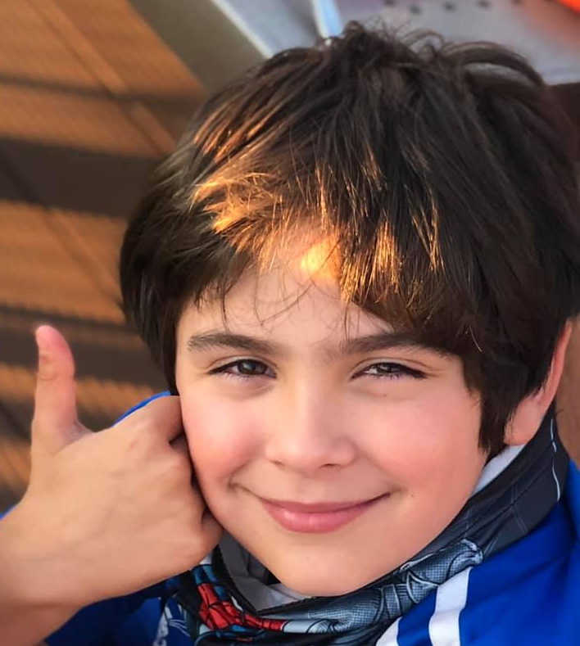
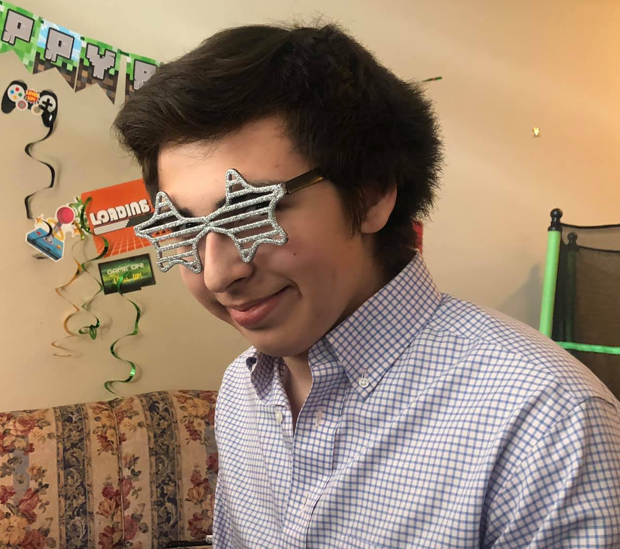
Remote ISD Learning Playbook
Lopez Family
Jonathan Angelina Elias
11th Grade 6th Grade 3rd Grade

Slide 2


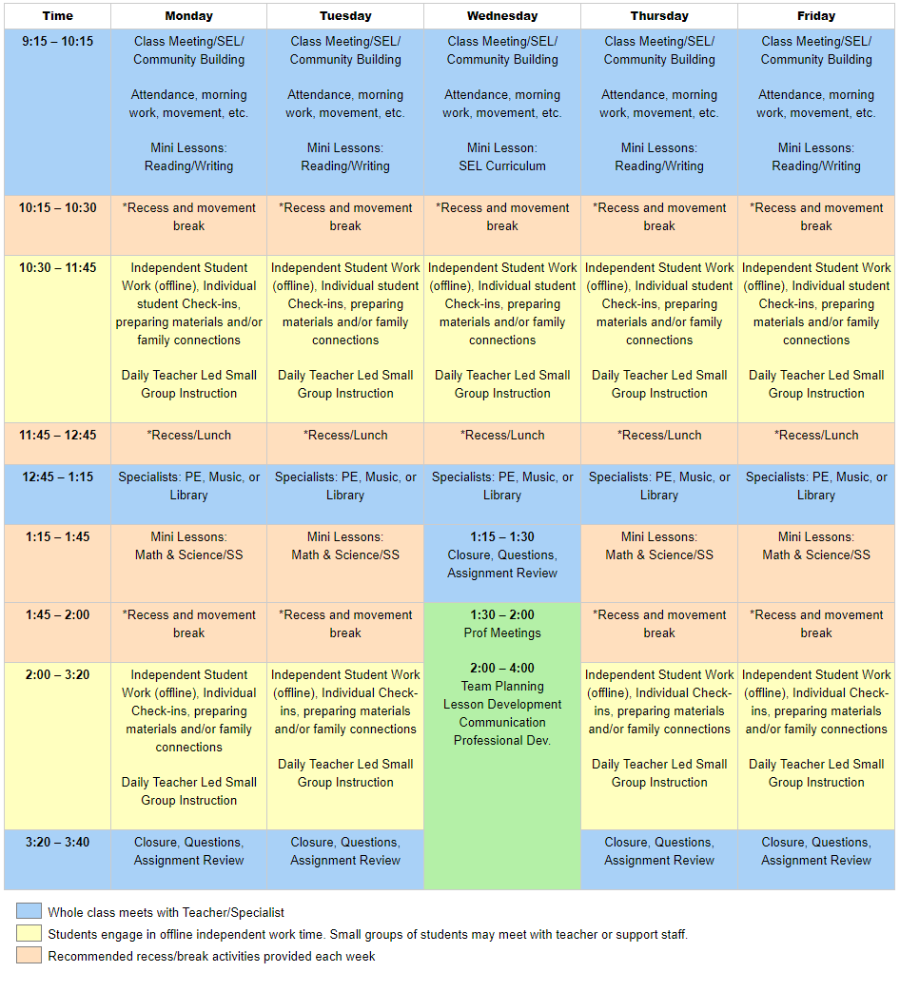
Elias L.I.V.E Schedule
Clark Website
issaquah.wednet.edu/clark
The sample schedules below illustrate the start/stop times of the school day, in addition to the variety of learning opportunities throughout the week. Specific aspects of your child’s individual daily schedule may look different. Teachers will share their class schedules with families prior to the first day of school.
A few highlights of the elementary schedule include:
Live whole class experiences/meetings to start and end each day
Daily social emotional learning and community building activities
Regular PE, Music and Library specialist time
Opportunities for students to meet with other support teachers/staff (ex. SAGE, ELL, Title, Counselor, Special Education Teacher, etc.)
Recommended activities to promote physical, social and emotional well-being
Family Access
Phone (425) 837-6300
Attendance Office:
(425) 837-6240
Attendance Email: clkattendance@issaquah.wednet.edu

Slide 3

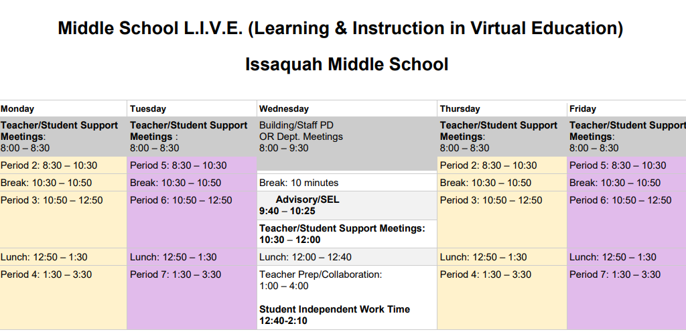
Angelina L.I.V.E Schedule
Aside from the robust opportunities the middle and high school schedules provide all students, additional benefits include:
A balance between screen time and independent off-line work each class period
Weekly Social and Emotional Learning lessons
Intentional scheduling to meet the required high school credit accrual
Alignment (as much as possible) to the typical school schedule
Phone (425) 837-6800
Attendance Office:
(425) 837-6800
Attendance Email
imsattendance@issaquah.wednet.edu
Important Links:
IMS Events and website
Welcome to IMS Video - for Incoming 6th Graders and Families
Principal Video on How To Use Schedule with Canvas
School Supply List
Digital Tools for Students
Family Access
Staff contact information

Slide 4

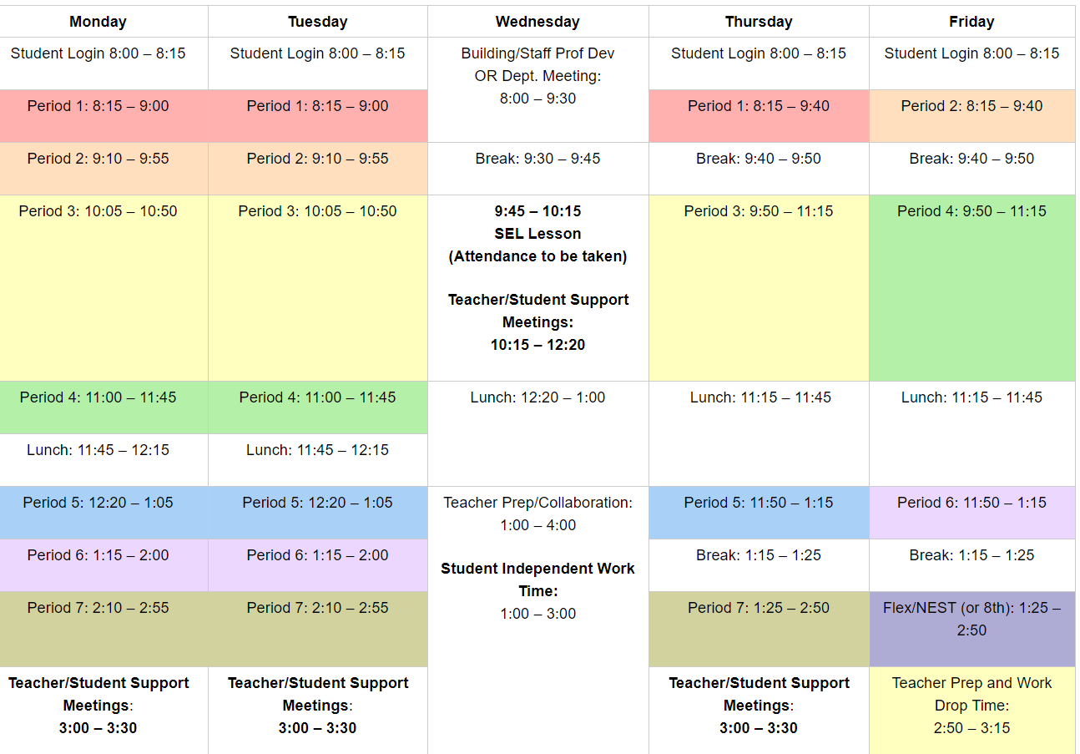
Jonathan L.I.V.E. Schedule
Aside from the robust opportunities the middle and high school schedules provide all students, additional benefits include:
A balance between screen time and independent off-line work each class period
Weekly Social and Emotional Learning lessons
Intentional scheduling to meet the required high school credit accrual
Alignment (as much as possible) to the typical school schedule
Phone (425) 837-6000
Attendance Office:
(425) 837-6012
Attendance Email
IHSattendance@issaquah.wednet.edu
Important Links:
IHS Website Band Website
All events for the IHS Year
Principal Video on Remote Scheduling – Loom Video
Family Access
Schedule change flow chart

Slide 5


Learning Platform Information
Canvas and Tech Support page here.
Canvas for Students
Go to: https://issaquah.instructure.com/login Training: Canvas for Students 101.
USERNAME: Same as the student network/computer username. Typically, this is the first four letters of the last name, first three letters of the first name and last two numbers of the graduation year.
For example, John Smith who graduates in 2022 would have the username SmitJoh22.
PASSWORDS: The 7-digit student ID number followed by ISD (in capital letters). Example: 1234567ISD Students may login to Canvas anytime between now and the start of school to verify their account.
The district has created a student and parent support page with tutorials, videos and login information. It can be found here: https://www.issaquah.wednet.edu/district/departments/Technology/canvas
Canvas for Parents/Guardians
Go to: https://issaquah.instructure.com/login
In addition to student Canvas accounts, parents have an ‘observer’ role in Canvas. This role will link parents to their student(s) courses within Canvas.
USERNAME: parent email as listed in Skyward. Click “Forgot password” to create your password. Once logged in, your student(s) classes will show on the Dashboard. Parents can learn more about Canvas by vising our Canvas for Parents & Guardians 101.
More information about Canvas Family App including a video overview can be found here: https://www.issaquah.wednet.edu/district/departments/Technology/canvas
FAQ’s https://www.issaquah.wednet.edu/reopening/faq

Slide 6

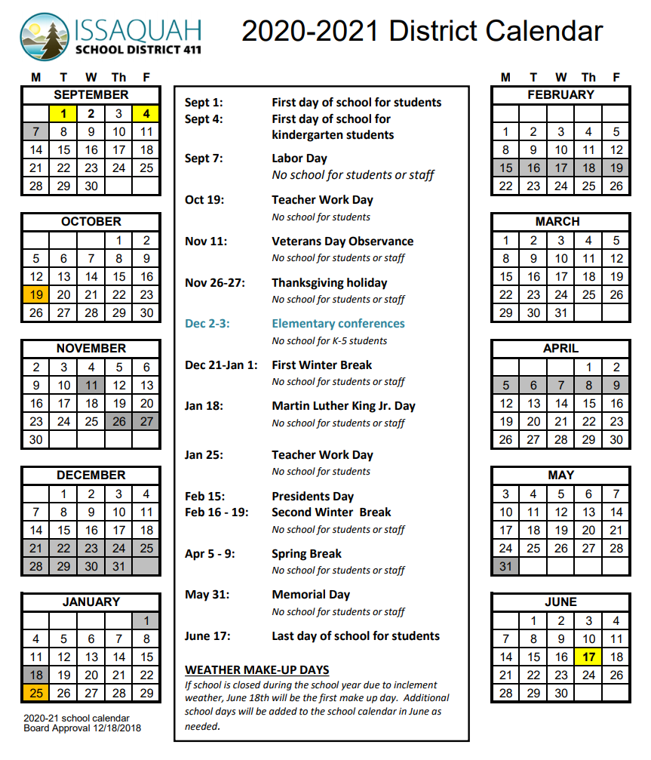

Slide 7
Each school has unique save the dates be sure to check back often.
Clark Elementary
Issaquah Middle School
Issaquah High School
IHS Zoom drop in schedule change event
August 31 at 9:00 am – 12:00 pm
IMS WEB Orientation for 6th Graders - Virtual - 10:00 a.m.
August 31
6th Grade Parent Orientation - Virtual
August 31 at 5:00 pm – 6:00 pm
1st Day of School!!! Special Schedule
September 1
Labor Day - No School
No school for students or staff.
September 7
Student materials pick up ~
September 8th-17th
September 8 – September 17
ASB Food Drive
September 8 at 8:00 am – September 17 at 3:00 pm
Virtual Curriculum Night ~ September 10th
September 10 at 6:00 pm – 7:30 pm
IMS Curriculum Night - Virtual
September 15
Teacher Work Day: No School For Students
October 19
IMS WEBtivity
November 5 at 2:45 pm – 4:15 pm
IMS Kindness Week
November 16 – November 20
Veterans Day Observance- No School
No school for students or staff.
November 11
Thanksgiving Holiday- No School
No school for students or staff.
November 26 – November 27
First Winter Break - No School
No school for students or staff.
December 21 – January 1
Martin Luther King Jr. Day - No School
No school for students or staff.
January 18
Teacher Work Day - No School for Students
January 25
Second Winter Break - No School
No school for students or staff.
February 15 – February 19
Spring Break - No School
No school for students or staff.
April 5 – April 9
Memorial Day - No School
No school for students or staff.
May 31
Last Day of School
June 17

Slide 8

Digital Tools
ISD Home Page:
https://www.issaquah.wednet.edu/
Digital Tool | Purpose | Access | Student Login Information
Classlink | ClassLink is a tool that provides secondary students and staff with easy access to a variety of tools and tech resources available to them. It is also a password locker making logging in easier! Learn more Resetting stored password | 6-12 | Username: ISD Computer username (first 4 of last name, first 3 of first name, grade year e.g. LastFir25) Password: School computer password
Clever | Clever is the online portal for elementary students to access Zearn (Math), Quaver (Music), and other educational technology tools. Learn more with this video tutorial | K-5 | Username: Student Username (first 4 of the last name, first 3 of the first name & 2 digit graduation year) Password: Student ID QR codes might be available for K-2 (refer to teacher)
Actively Learn | Actively Learn is an e-reading platform that improves students' reading comprehension and retention by empowering teachers to reach students inside a text. Teachers can customize instruction, provide real-time feedback, allow peers to collaborate, and get analytics on student performance. | 6-12 | Classlink 6-12 Microsoft login and password (may need to create an account the first time logging in). Please choose "Log in with Office"
BrainPop | Brain Pop allows teachers to assign differentiated activities to students and monitor their progress. Activities include Make-a-Map, Make-a-Movie, Challenge, games, videos and more. It encourages independent learning. | 6-8 | Classlink
Office 365, Teams and student email Use this Wakelet to learn more about Office 365 and Teams. | Office 365 is Microsoft’s subscription-based service that gives users access to the familiar, desktop office applications through the web browser and access to its cloud storage solution. More Information Teams: Video Overview Assignments and Feedback Video Outlook (student email):English: Info on Accessing Teams and Office 365 | 6-12 | Classlinkor directly from Office.com Username: school email (username@issaquah.wednet.edu) Password: school computer password
Seesaw | Seesaw gives students creative tools to capture and reflect on their learning – in real-time. | 6-12 | As defined by classroom teacher
Canvas | A Learning Management System (LMS) used to facilitate teaching and learning throughout the district. | 6-12 | Canvas Username is computer login Password is Student ID# + ISD OR Classlink - Classlink will save your username and password
Discovery Ed | Discovery Education offers an online curriculum with a variety of supplemental texts, multimedia content, lesson plans and PD | 6-12 | Classlink Username is the computer login Password: issaquah
Online Textbooks | Online textbooks are available for a variety of content and curriculum. | 6-12 | Classlink
King County Library Systems | Access to all of KCLS online information and tools. | K-12 | User Name: 4 1 1 _ _ _ _ _ _ _ (7 digit ASB card number) PIN/Passcode: _ _ _ _ (Last 4 digits of ASB card number)
Skyward/Family Access | Family Access gives parents and students on-line access to student information, including test scores, attendance, class schedules, and immunization records. Parents can verify on-line that the emergency contact information on each student is correct. More information is available here. | K-12 | Students: School username and password they chose. Parents: District provided username and password you chose.
Common Sense Media | A resource for teachers and families on educational apps, movies, music, video games and other digital content.

